Slide 1
Presentation title here
Speaker Name | Date

Slide 2
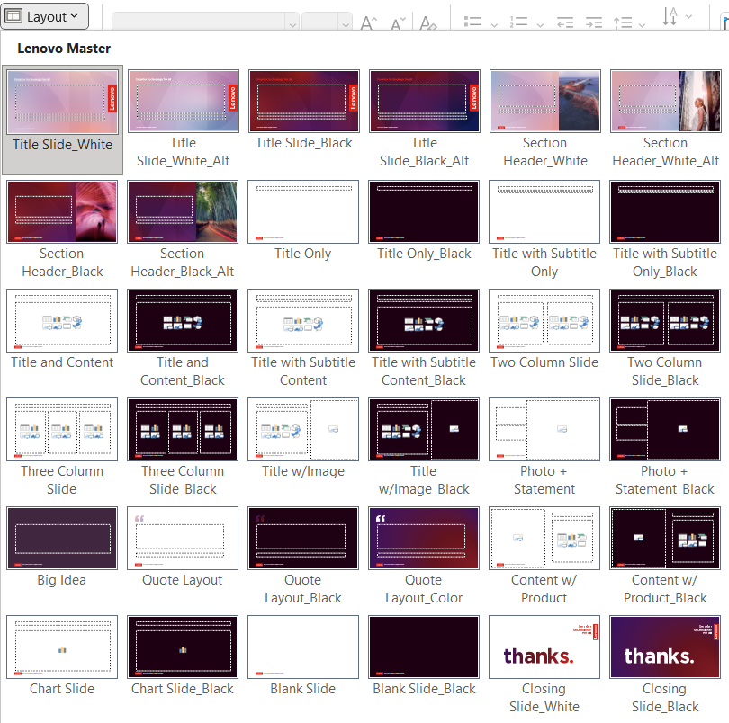
Template layouts
Discover all available slide layouts by following these instructions:
Right click on a thumbnail in slide panel on left and select “Layout” to choose an option based on your content needs OR
From the Home tab, choose the “Layout” dropdown
Layout options between “Title Slide_White” and “Closing Slide_Black” are considered part of the current template
Any Layout options appearing after “Closing Slide_Black” are legacy artifacts from older templates and should not be used and can be deleted (typically show up when copying old slides into the new template)

Slide 3
Template 101
For every slide layout option, there is an alternative dark option
For slides that will be printed, use white slide layouts to conserve toner
Dark slides are a dramatic alternative for formal presentations that will be projected on screen
Bold color is your highlight text, text, text, text, text, text, text
Try not to exceed six bullet points per slide
Tips for transferring content from other templates:
After pasting, choose “Use Destination Theme” from the fly out menu
You may still have to copy/paste or cut/paste content into the correct content placeholder depending on how the source file was created
Do not copy and paste entire slides from the slide pane. Instead, copy and paste the content within the slide

Slide 4
How to make this your default template
Choose the Office Button and click Save As
Select PowerPoint Template (*.potx) from the Save As menu
PowerPoint automatically chooses the correct folder for you
Name the template Blank.POTX
Click Save
Now PowerPoint will base new presentations on your blank.potx template file

Slide 5
Installing theme files
If using Windows 10: Open File Explorer from the taskbar. Select View > Options > Change folder and search options. Select View. Select Show hidden files, folders, and drives. Select Apply.
Navigate to: C:\Users\Your User Name\AppData\Roaming\Microsoft\Templates
Copy the template file (.potx) to the “Templates” folder
Open “Document Themes” folder, copy the theme file (.thmx) to this folder

Slide 6
Update footer with correct information classification
Select “Home” tab, then “Replace” button. Put current footer text in “Find” field, then type the appropriate footer content from options below. Click “Replace All” to update all slides.
Lenovo Internal: Information generally intended for use within Lenovo without restrictions. Much of Lenovo's internal information can use this template.
Lenovo Confidential (additional protection required): Confidential within Lenovo, with distribution limited to individuals only with a specific business need to know.
Lenovo Unclassified (no protection required): does not include any Lenovo Internal, Lenovo Confidential or Lenovo Restricted content. Information is in the public domain or is approved for disclosure outside of Lenovo.
Lenovo Restricted (maximum protection required): Confidential within Lenovo, with distribution limited to only designated individuals or positions.
2022 Lenovo Internal. All rights reserved.
2022 Lenovo Confidential. All rights reserved.
2022 Lenovo
Download Restricted Template Here

Slide 7
Color scheme
Red
225.37.27
#E1251B
Deep Red 1
100.19.30
#64131E
Deep Purple 1
77.20.74
#4D144A
Deep Blue 1
17.24.79
#11184F
Black
30.01.19
#1E0013
Mid Red 1
184.37.46
#B8252E
Deep Purple 2
122.18.107
#7A126B
Deep Blue 2
41.78.149
#294E95
Deep Gray
78.68.78
#4E444E
Lenovo signature red should be used to elevate the brand, not overused. Always use the signature red for the Lenovo logo.
Mid Red 2
242.106.82
#F26A52
Mid Gray
171.168.177
#ABA8B1
Colors built into the template (theme colors)
Pale Red 1
240.199.191
#F0C7BF
Pale Purple 1
217.193. 216
#D9C1D8
Pale Blue 1
201.208.240
#C9D0F0
Pale Gray
230.226.228
#E6E2E4
Passion
Ambition
Curious
Wonder
SMARTER GRADIENTS:

Slide 8
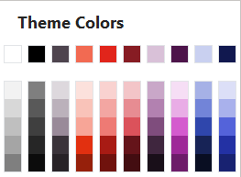
Colors for light slides
Use deep and bold colors that contrast with the white background
Avoid the paler tones that do not allow enough contrast with the white background

Slide 9
Colors for dark slides
Use light and bold colors that contrast with the background
Avoid the darker tones that do not allow enough contrast with the background

Slide 10
Section divider
Subhead placeholder

Slide 11
Titles are Arial, bold, 32 pt, sentence case
Subtitles are Arial, regular, 22 pt, sentence case
First level bullet copy is Arial, regular, 20 pt
Sub bullet copy is Arial, regular, 18 pt
Bulleted copy has initial cap on first word only with no period at the end

Slide 12
Two column layout
Two-column first level bullets are Arial, regular, 20 pt
Sub bullet is Arial, regular, 18 pt
Level one style
Level one style
Level one style
Two-column first level bullets are Arial, regular, 20 pt
Sub bullet is Arial, regular, 18 pt
Level one style
Level one style
Level one style

Slide 14

Content w/ product
Level one style
Level two style
Level three style
Level one style
Level two style
Level three style
2022 Lenovo Internal. All rights reserved.

Slide 15
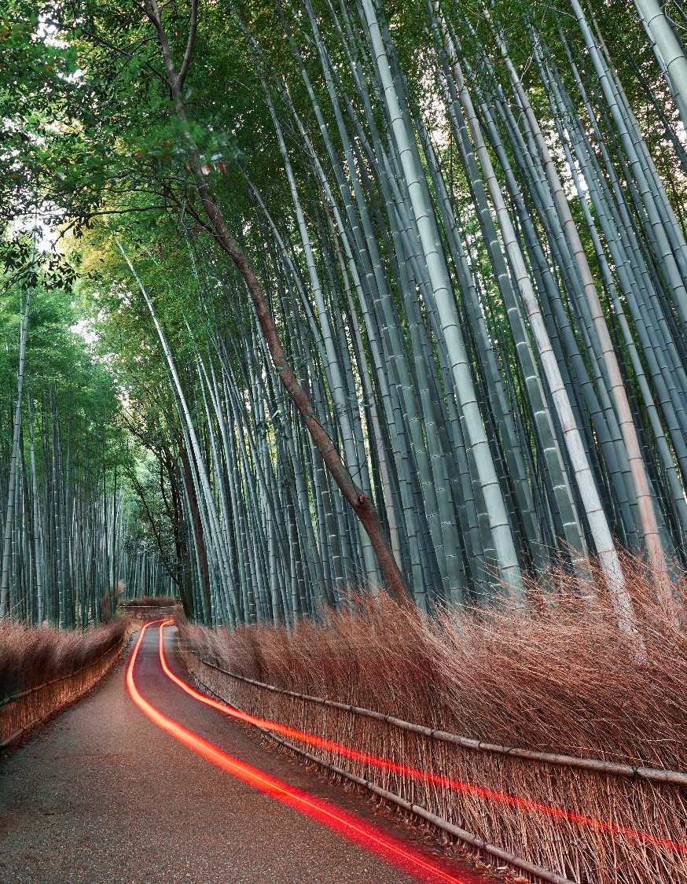
Content w/ image layout
Level one style
Level two style
Level three style

Slide 16

Photo plus statement layout
Subtitle goes here

Slide 17
Quote layout
Quote source

Slide 18
Charts overview
How to use template charts
If starting with a chart from the template, double-click the chart to bring up the data table and edit placeholder data
If creating a new chart, select from the Templates folder within the Chart Type window
If Templates folder is not visible, refer to Installing Theme Files instructions
If you have to create a new chart because the type you need is not available in this template (ex: a scatter or area chart), follow these guidelines
Use only the Lenovo palette colors for chart elements
Use the minimum amount of data and text needed to convey your point

Slide 19
Bar chart
Source: Placement Goes Here

Slide 20
Line chart
Source: Placement Goes Here

Slide 21
Pie chart
Source: Placement Goes Here

Slide 22
Tables
Column 1 | Column 2 | Highlight | Column 4 | Column 5
0.00 | 0.00 | 0.00 | 0.00 | 0.00
0.00 | 0.00 | 0.00 | 0.00 | 0.00
0.00 | 0.00 | 0.00 | 0.00 | 0.00
0.00 | 0.00 | 0.00 | 0.00 | 0.00
0.00 | 0.00 | 0.00 | 0.00 | 0.00
0.00 | 0.00 | 0.00 | 0.00 | 0.00
0.00 | 0.00 | 0.00 | 0.00 | 0.00
0.00 | 0.00 | 0.00 | 0.00 | 0.00
0.00 | 0.00 | 0.00 | 0.00 | 0.00
0.00 | 0.00 | 0.00 | 0.00 | 0.00
Source: Placement Goes Here

